Slide 1
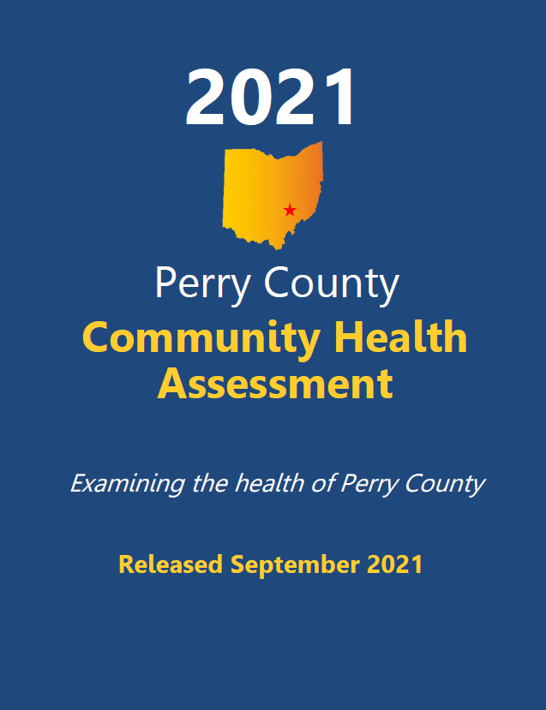
2021 Perry County Health Status Assessment Report
Community Release Event Presented by:
Emily Gensler, MPH Hospital Council of Northwest Ohio

Slide 2
Commissioned and Funded by:
The Southeast Ohio Health Improvement Collaborative:
Coshocton City Health Department
Coshocton County Health Department
Genesis HealthCare System
Morgan County Health Department
Noble County Health Department
Ohio Alliance for Population Health
Ohio University’s College of Health Sciences and Professions
Ohio University’s Voinovich School of Leadership and Public Service
Perry County Health Department
Zanesville/Muskingum County Health Department

Slide 3
Acknowledgements
Project Management, Primary Data Collection, Secondary Data Collection,
and Report Development
Hospital Council of Northwest Ohio
Emily Gensler, MPH, Community Health Improvement Manager
Mallory Ohneck, MPH, CHES Community Health Improvement Data Manager
Gabrielle MacKinnon, MPH, Community Health Improvement Manager
Jodi Franks, CHES, Graduate Assistant
Data Collection & Analysis
Joseph A. Dake, Ph.D., MPH, Professor and Chair, School of Population Health, University
of Toledo
Aaron J. Kruse-Diehr, PhD, CHES, Consultant
Samantha Schroeder, MPA, Consultant
Ohio University’s College of Health Sciences and Professions
Ohio University’s Voinovich School of Leadership and Public Service

Slide 4
Overview
Health Care Coverage
Health Care Access and Utilization
Preventive Medicine
Women’s Health
Men’s Health
Oral Health
Health Status Perceptions
Weight Status
Tobacco Use
Alcohol Consumption
Drug Use
Sexual Behavior
Mental Health
Cardiovascular Health
Cancer
Arthritis
Asthma
Diabetes
Quality of Life
Social Determinants of Health
Environmental Conditions
Parenting

Slide 5
Methodology
Design
Written surveys
Instrument Development
Majority of questions from national surveys (BRFSS)
Procedure
2-wave mailing campaign
Advance wave
First wave
Gift card drawing

Slide 6
Methodology
Adult
26,099 adults ages 19 and over
Response Rate
6% (n=180: CI= ± 7.28)
Power analysis #: 264

Slide 7
Methodology
Data Analysis
Analyzed using SPSS 26.0
Data weighted to reflect population statistics
Limitations
Adult data collection: CDC-telephone surveys
Self-reported data
Caution should be used when interpreting subgroup results as the margin of error for any subgroup is higher than that of the overall survey
IRB Approval
IRB approval granted to Ohio University by their universities Social and Behavioral IRB

Slide 8
Demographics: Race/Ethnicity
Percentages may not add to 100% due to missing data (non-responses).

Slide 9
Demographics: Marital Status
Percentages may not add to 100% due to missing data (non-responses).

Slide 10
Demographics: Education
Percentages may not add to 100% due to missing data (non-responses).

Slide 11
Demographics: Income
Percentages may not add to 100% due to missing data (non-responses).

Slide 12
Health Care Access Health Care Coverage Health Care Access and Utilization Preventive Medicine Women’s Health Men’s Health Oral Health

Slide 13
Health Care Coverage
91% of adults had health care coverage
9% of adults were without coverage
9% of adults with children did not have health care coverage
Compared to 8% of those who did not have children living in their household

Slide 14
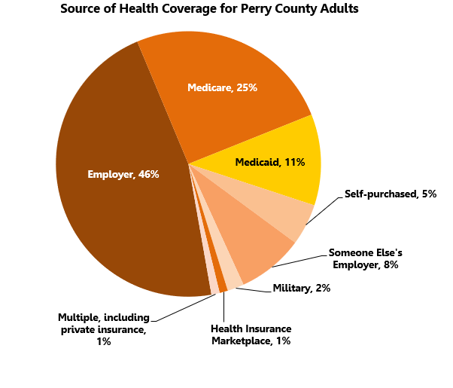
Health Care Coverage

Slide 15
Health Care Coverage
Adult Comparisons | Perry County 2021 | Ohio 2019 | U.S. 2019
Uninsured | 9% | 9% | 11%

Slide 16
Health Care Access & Utilization
66% of Perry County adults visited a doctor for a routine checkup in the past year
Increasing to 84% of those ages 65 and older
82% of adults indicated they had at least one person they thought of as their personal doctor or health care provider
69% of adults went outside of Perry County for health care services in the past year

Slide 17
Health Care Access & Utilization
The following might prevent Perry County adults from getting medical care if they were sick or needed some time of health care:
Cost/no insurance (23%)
Difficult to get an appointment (17%)
Worried they might find something wrong (16%)
Inconvenient hours (14%)
Could not get time off work (14%)
Provider would not take their insurance (12%)
Frightened of the procedure or doctor/health care provider (12%)
Could not find childcare (7%)
Difficult to find/no transportation (3%)
Did not trust or believe doctors/health care providers (1%)
Dome other reason (4%)

Slide 18
Preventive Medicine
56% of Perry County adults had a flu vaccine in the past year
Increasing to 79% of adults ages 65 and older
25% of adults have had a pneumonia vaccine in their life
Increasing to 69% of those ages 65 and over
Adults had the following vaccines:
Measles, mumps, and rubella (MMR) in their lifetime (80%)
Tetanus, diphtheria, and pertussis in the past ten years (73%)
Chicken pox vaccine in their lifetime (67%)
Hepatitis B vaccine in their lifetime (41%)
Hepatitis A vaccine in their lifetime (30%)
Hemophilus influenzae or influenza type B vaccine in their lifetime (30%)
Meningococcal vaccine in their lifetime (22%)
Etc.

Slide 19
Preventive Medicine
Adult Comparisons | Perry County 2021 | Ohio 2019 | U.S. 2019
Had a flu vaccine in the past year (ages 65 and older) | 79% | 63% | 64%
Ever had a pneumonia vaccine in lifetime (ages 65 and older) | 69% | 75% | 73%
Ever had a shingles or zoster vaccine | 17% | 29%* | 29%*
*2017 BRFSS Data

Slide 20
Women’s Health
53% of all Perry County women had a mammogram at some time in their life and 25% had one in the past year
46% of women ages 40 and over had a mammogram in the past year
94% of women had a Pap smear at some time in their life and 50% had one in the past year
42% of women had a Pap smear in the past three years
Adult Comparisons | Perry County 2021 | Ohio 2018 | U.S. 2018
Had a mammogram within the past two years (ages 40 and older) | 61% | 74% | 72%
Had a Pap smear in the past three years (ages 21-65) | 70% | 79% | 80%

Slide 21
Women’s Health
During their last pregnancy in the past five years, Perry County women:
Received prenatal care within the first three months (70%)
Took a multi-vitamin with folic acid (53%)
Experienced depression during or after pregnancy (50%)
Received a dental exam during pregnancy (40%)
Received WIC services (40%)
Etc.
Women used the following as their usual source of services for female health concerns
Private gynecologist (49%)
General or family physician (24%)
Family planning clinic (6%)
Community health center (6%)
Etc.

Slide 22
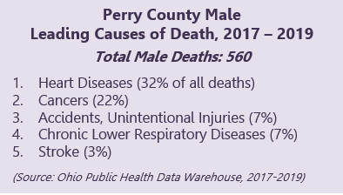
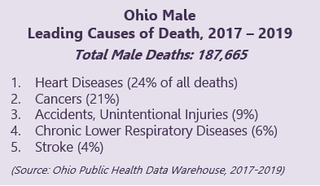
Men’s Health
62% of Perry County males had a prostate-specific antigen (PSA) test at some time in their life
37% had one in the past year
Adult Comparisons | Perry County 2021 | Ohio 2018 | U.S. 2018
Had a prostate-specific antigen (PSA) test in the past two years (age 40 and older) | 55% | 34% | 33%

Slide 23
Oral Health
56% of adults had visited a dentist or dental clinic in the past year
Decreasing to 33% of those with incomes less than $25,000
65% of adults with dental insurance had been to the dentist in the past year, compared to 52% of those without dental insurance
When asked the main reason for not visiting a dentist in the last year, Perry County adults gave the following responses:
Cost (30%)
Fear, apprehension, nervousness, pain, and dislike going (26%)
Had dentures (22%)
Did not have/know a dentist (6%)
Etc.

Slide 24
Oral Health
Adult Comparisons | Perry County 2021 | Ohio 2018 | U.S. 2018
Visited a dentist or a dental clinic (within the past year) | 56% | 67% | 68%

Slide 25
Health Behaviors Health Status Perceptions Weight Status Tobacco Use Alcohol Consumption Drug Use Sexual Behavior Mental Health

Slide 26
Health Status Perceptions
General health status
43% of Perry County adults rated their health as excellent or very good
18% rated their health as fair or poor
42% rated their mental health as not good on 4 or more days in the previous month
27% reported their physical health was not good on 4 or more days in the previous month
37% reported that poor physical or mental health kept them from doing usual activities, such as self-care, work, or recreation for at least one day during the past month

Slide 27
Health Status Perceptions
*Respondents were asked: “Would you say that in general your health is excellent, very good, good, fair or poor?”

Slide 28
Health Status Perceptions
Adult Comparisons | Perry County 2021 | Ohio 2019 | U.S. 2019
Rated health as excellent or very good | 43% | 48% | 51%
Rated general health as fair or poor | 18% | 19% | 18%
Rated mental health as not good on four or more days (in the past month) | 42% | 26%* | 24%*
Rated physical health as not good on four or more days (in the past month) | 27% | 24%* | 23%*
Average number of days that mental health was not good (in the past month)* | 7.4 | 4.8‡ | 4.1‡
Average number of days that physical health not good (in the past month)* | 5.5 | 4.1‡ | 3.7‡
Poor physical or mental health kept them from doing usual activities, such as self-care, work, or recreation (on at least one day during the past month) | 37% | 24%* | 24%*
‡2018 BRFSS as compiled by 2021 County Health Rankings
* 2018 BRFSS data

Slide 29
Adult Weight Status
73% of Perry County adults were overweight (26%) or obese (47%) based on body mass index (BMI)
Adults did the following to lose weight or keep from gaining weight in the past month:
Exercised (44%)
Ate less food, fewer calories, or foods low in fat (37%)
Drank more water (35%)
Ate a low-carb diet (18%)
Took diet pills, powders or liquids without a doctor’s advice (5%)
Etc.
Adult Comparisons | Perry County 2021 | Ohio 2019 | U.S. 2019
Overweight (BMI of 25.0 – 29.9) | 26% | 35% | 35%
Obese (includes severely and morbidly obese, BMI of 30.0 and above) | 47% | 35% | 32%

Slide 30
Adult Weight Status
14% of adults ate five or more servings of fruits and/or vegetables per day
40% ate three to four servings per day
42% ate one to two servings per day
3% ate zero servings per day
60% of adults engaged in some type of physical activity at least 30 minutes on three or more days per week
19% did not participate in any physical activity in the past week, including 4% who were unable to exercise

Slide 31
Adult Weight Status
*Percentages may not equal 100% due to the exclusion of data for those who were classified as underweight

Slide 32
Adult Tobacco Use
18% of Perry County adults were current smokers
25% of adults were former smokers
Perry County adults used the following tobacco products in the past year:
Cigarettes (23%)
Chewing tobacco, snuff, or snus (13%)
E-cigarettes/vapes (8%)
Cigars (3%)
Little cigars (2%)
Etc.
33% of current smokers had stopped smoking for at least one day in the past year because they were trying to quit

Slide 33
Adult Tobacco Use
*Respondents were asked: “Have you smoked at least 100 cigarettes in your entire life? If yes, do you now smoke cigarettes every day, some days or not at all?”
Adult Comparisons | Perry County 2021 | Ohio 2019 | U.S. 2019
Current smoker (smoked on some or all days) | 18% | 21% | 16%
Former smoker (smoked 100 cigarettes in lifetime and now do not smoke) | 25% | 24% | 25%

Slide 34
Adult Alcohol Consumption
53% of Perry County adults had at least one alcoholic drink in the past month
On the days when they drank, adult drinkers consumed 4.1 drinks on average
Increasing to 6.5 drinks for males
21% of all adults were considered binge drinkers
14% of current drinkers reported driving a vehicle after having perhaps too much alcohol in the past month

Slide 35
Adult Alcohol Consumption
Adult Comparisons | Perry County 2021 | Ohio 2019 | U.S. 2019
Current drinker (had at least one drink of alcohol within the past month) | 53% | 51% | 54%
Binge drinker (males having five or more drinks on one occasion, females having four or more drinks on one occasion) | 21% | 18% | 17%
Drove after having perhaps too much alcohol to drink (in the past month) | 14% | 4%* | 3%*
*2018 BRFSS Data

Slide 36
Adult Drug Use
Adults reported they and/or an immediate family member/someone in their household used the following in the past six months:
Recreational marijuana or hashish (17%)
Cannabidiol (CBD) oil (16%)
Wax, oil, or edibles with THC (8%)
Medical marijuana (4%)
Amphetamines, methamphetamine or speed (2%)
Cocaine, crack, or coca leaves (2%)
Heroin/fentanyl (2%)
Bath salts (1%)
Ecstasy, E, or GHB (1%)
Synthetic marijuana/k2 (1%)

Slide 37
Adult Drug Use

Slide 38
Adult Drug Use
7% of adults reported misusing prescription medication in the past 6 months
Perry County adults indicated they did the following with their unused prescription medication:
Took as prescribed (38%)
Threw it in the trash (20%)
Kept it (16%)
Flushed it down the toilet (14%)
Took it to the medication collection program (13%)
Took it in on national drug take back day (6%)
Kept it in a locked cabinet (6%)
Took it to the sheriff’s office (2%)
Used drug deactivation pouches (1%)
Gave it away (1%)
Etc.

Slide 39
Adult Drug Use

Slide 40
Adult Sexual Behavior
72% of adults had sexual intercourse in the past year
5% of adults reported they had intercourse with more than one partner in the past year
Adults used the following methods of birth control:
They or their partner were too old to get pregnant (16%)
Male sterilization (vasectomy) (15%)
Birth control pills, any kind (14%)
Male or female condoms (12%)
Withdrawal (12%)
Female sterilization (tubes tied) (10%)
IUD (e.g., Mirena) (6%)
Contraceptive implant (e.g., Nexplanon) (6%)
Hysterectomy (3%)
Etc.

Slide 41
Adult Sexual Behavior
*Respondents were asked: “During the past 12 months, with how many different people have you had sexual intercourse?”

Slide 42
Adult Mental Health
20% of adults felt so sad and hopeless everyday for two weeks or more in a row that they stopped doing usual activities
32% of adults were told they had a depressive disorder
8% of adults considered attempting suicide in the past year
No adults (0%) reported attempting suicide in the past year

Slide 43
Adult Mental Health
Adults indicated the following caused them anxiety, stress, or depression:
Job stress (39%)
Financial stress (33%)
Current news/political environment (31%)
Death of close family member or friend (25%)
Sick family member (22%)
Marital/dating relationships (20%)
Poverty/no money (19%)
Etc.
15% of adults used a program or service to help with depression, anxiety, or other emotional problems for themselves or a loved one

Slide 44
Chronic Disease Cardiovascular Health Cancer Arthritis Asthma Diabetes Quality of Life

Slide 45
Cardiovascular Health
7% reported they had survived a heart attack
Increasing to 11% of those over the age of 65
5% reported they had survived a stroke
7% reported they were diagnosed with angina or coronary heart disease
Increasing to 14% of males
38% were diagnosed with high blood pressure
38% were diagnosed with high blood cholesterol

Slide 46
Cardiovascular Health
Adult Comparisons | Perry County 2021 | Ohio 2019 | U.S. 2019
Had angina or coronary heart disease | 7% | 5% | 4%
Had a heart attack | 7% | 5% | 4%
Had a stroke | 5% | 4% | 3%
Had been diagnosed with high blood pressure | 38% | 35% | 32%
Had been diagnosed with high blood cholesterol | 38% | 33% | 33%
Had their blood cholesterol checked within the last five years | 72% | 85% | 87%

Slide 47
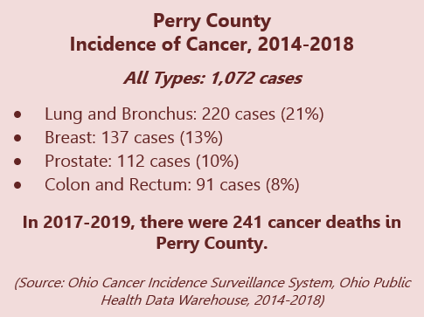
Cancer
13% of Perry County adults were diagnosed with cancer at some point in their lives

Slide 48
Arthritis
Adult Comparisons | Perry County 2021 | Ohio 2019 | U.S. 2019
Diagnosed with arthritis | 36% | 31% | 26%

Slide 49
Asthma
Adult Comparisons | Perry County 2021 | Ohio 2019 | U.S. 2019
Diagnosed with asthma | 14% | 16% | 15%

Slide 50
Diabetes
Adult Comparisons | Perry County 2021 | Ohio 2019 | U.S. 2019
Ever been told by a doctor they have diabetes (not pregnancy-related) | 11% | 12% | 11%
Had been diagnosed with pre-diabetes or borderline diabetes | 3% | 2% | 2%

Slide 51
Quality of Life
23% of adults reported they were limited in some way because of a physical, mental or emotional problem
Increasing to 43% of those with incomes less than $25,000
Among those who were limited in some way, the following most limiting problems or impairments were:
Back or neck problems (71%)
Arthritis/rheumatism (40%)
Chronic pain (30%)
Walking problems (30%)
Stress, depression, anxiety, or emotional problems (24%)
Other physical disability (24%)
Fractures, bone/joint injuries (22%)
Eye/vision problems (18%)
Sleep problems (17%)
Etc.

Slide 52
Quality of Life

Slide 53
Social Conditions Social Determinants of Health Environmental Conditions Parenting

Slide 54
Social Determinants of Health
Adults experienced the following food insecurity issues during the past year:
Had to choose between paying bills and buying food (8%)
Food assistance was cut (6%)
Loss of income led to food insecurity issues (3%)
Worried food would run out (2%)
Were hungry but did not eat because they did not have money for food (1%)
5% of Perry County adults experienced more than one food insecurity issue in the past year

Slide 55
Social Determinants of Health
Perry County adults reported the following adverse childhood experiences (ACEs):
Their parents became separated or were divorced (21%)
Lived with someone who was a problem drinker or alcoholic (18%)
A parent or adult in their home swore at them, insulted them, or put them down (18%)
Lived with someone who was depressed, mentally ill, or suicidal (18%)
Someone at least five years older than them or an adult touched them sexually (13%)
Their parents or adults in their home slapped, hit, kicked, punched, or beat each other up (13%)
Etc.
18% of adults experienced four or more ACEs

Slide 56
Social Determinants of Health
Perry County adults reported they would support the following community improvement initiatives:
More locally grown foods or farmer’s markets (67%)
Safe roadways (59%)
New/updated parks (52%)
Neighborhood safety (49%)
Bike/walking trail accessibility and connectivity (46%)
Local agencies partnering with grocery stores to provide healthier low-cost food items (45%)
New/updated recreation centers (40%)
Sidewalk accessibility (38%)
Community gardens (37%)
67% of Perry County adults kept a firearm in or around their home
9% of adults reported they were unlocked and loaded

Slide 57
Social Determinants of Health
The COVID-19 pandemic negatively impacted adults or their family’s health or well-being in the following ways:
Not seeking health care (17%)
Change in mental health (16%)
Changes to employment status (14%)
Educational challenges (13%)
Not seeking dental care (13%)
Change in physical health (12%)
Loss of household income (12%)
Financial instability (11%)
Increased alcohol use (8%)
Lack of childcare (8%)
Unable to afford basic needs, such as personal, household, or baby care (7%)
Lack of Internet access (7%)
Death or serious illness of loved one(s) (5%)
Etc.

Slide 58
Environmental Conditions
Perry County adults thought the following threatened their health in the past year:
Insects (11%)
Rodents (11%)
Mold (8%)
Moisture issues (6%)
Temperature regulation (heating and air conditioning) (6%)
Air quality (4%)
Unsafe water supply/wells (4%)
Plumbing problems (3%)
Sewage/wastewater problems (3%)
Agricultural chemicals (2%)
Asbestos (2%)
Bed bugs (2%)
Chemicals found in household products (2%)
Safety hazards (structural problems) (2%)
Etc.

Slide 59
Environmental Conditions
Perry County adults had the following disaster preparedness supplies:
Cell phone (89%)
Cell phone with texting (89%)
Working flashlight and working batteries (83%)
Working smoke detector (82%)
Computer/tablet (79%)
Reliable internet (65%)
Three-day supply of nonperishable food for everyone in the household (61%)
Three-day supply of prescription medication for each person who takes prescribed medicines (60%)
Etc.
17% of adults felt their household was well prepared to handle a large-scale disaster or emergency

Slide 60
Parenting
Parents discussed the following topics with their 12-to-17-year-old child in the past year:
Career plan/post-secondary education (80%)
Weight status (eating habits, physical activity, and screen time) (80%)
Social media issues (80%)
Dating and relationships (75%)
Energy drinks (45%)
Body image (40%)
Negative effects of alcohol, tobacco, illegal drugs or misusing prescription drugs (35%)
Etc.
5% of parents reported they did not talk about any of the above topics with their child

Slide 61
Questions?
You will now be given an opportunity to
provide participant feedback.
Emily Gensler, MPH
Hospital Council of Northwest Ohio
egensler@hcno.org

Slide 62
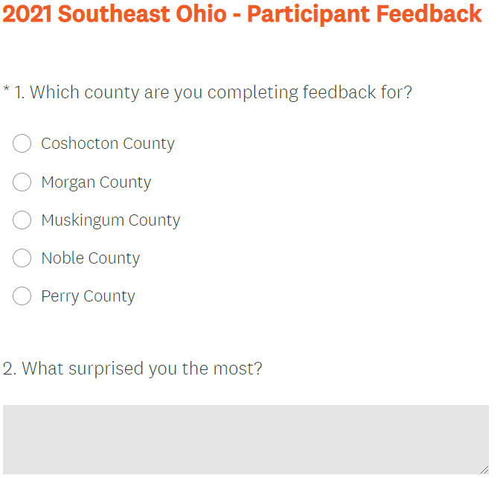
Participant Feedback
https://www.surveymonkey.com/r/feedback-se

